Slide 1
CIE 500 PROJECT HOW THE HEAVY SNOW AFFECT NYS HIGHWAY NETWORK
Prof. Fan
Dongyang Wu

Slide 2
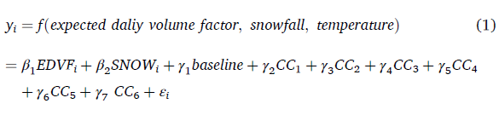
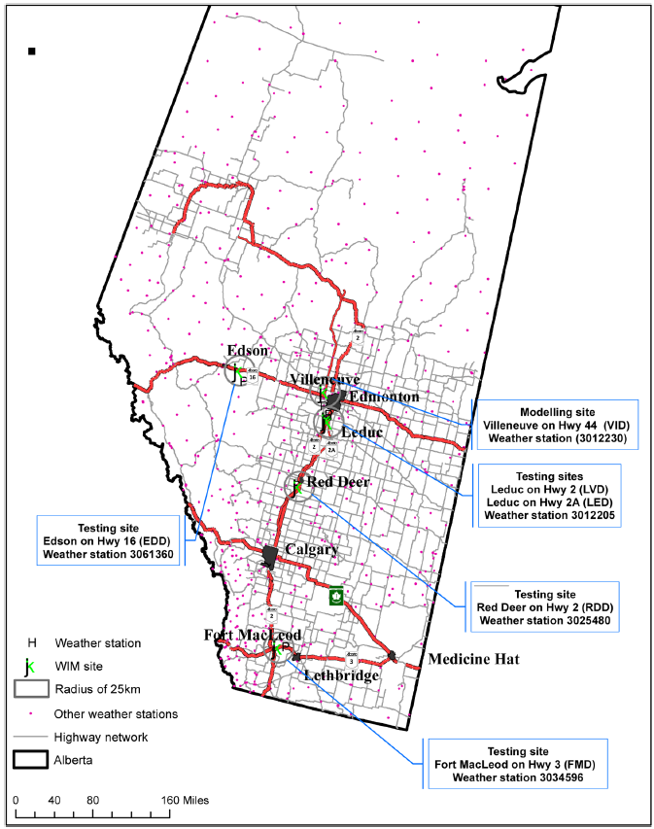
Literature review
Modelling Severe Weather Impact on Traffic Mobility in Cold Region Highway Networks
Study Focus: Analyzes how snowfall and temperature affect traffic volume on highways in Alberta, Canada.
Method: Regression models using EDVF, snowfall, and temperature for 6 highway sites.
Vehicle Classification: Used FDOT + PNN to separate passenger cars, light, and heavy trucks.

Slide 3
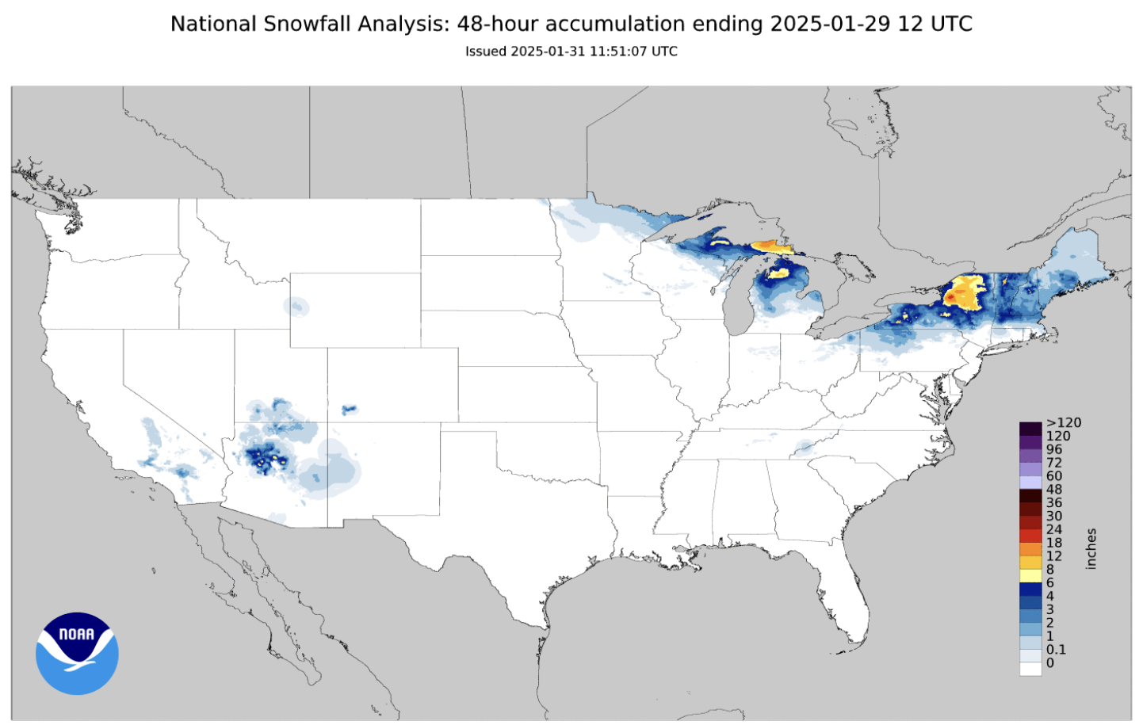
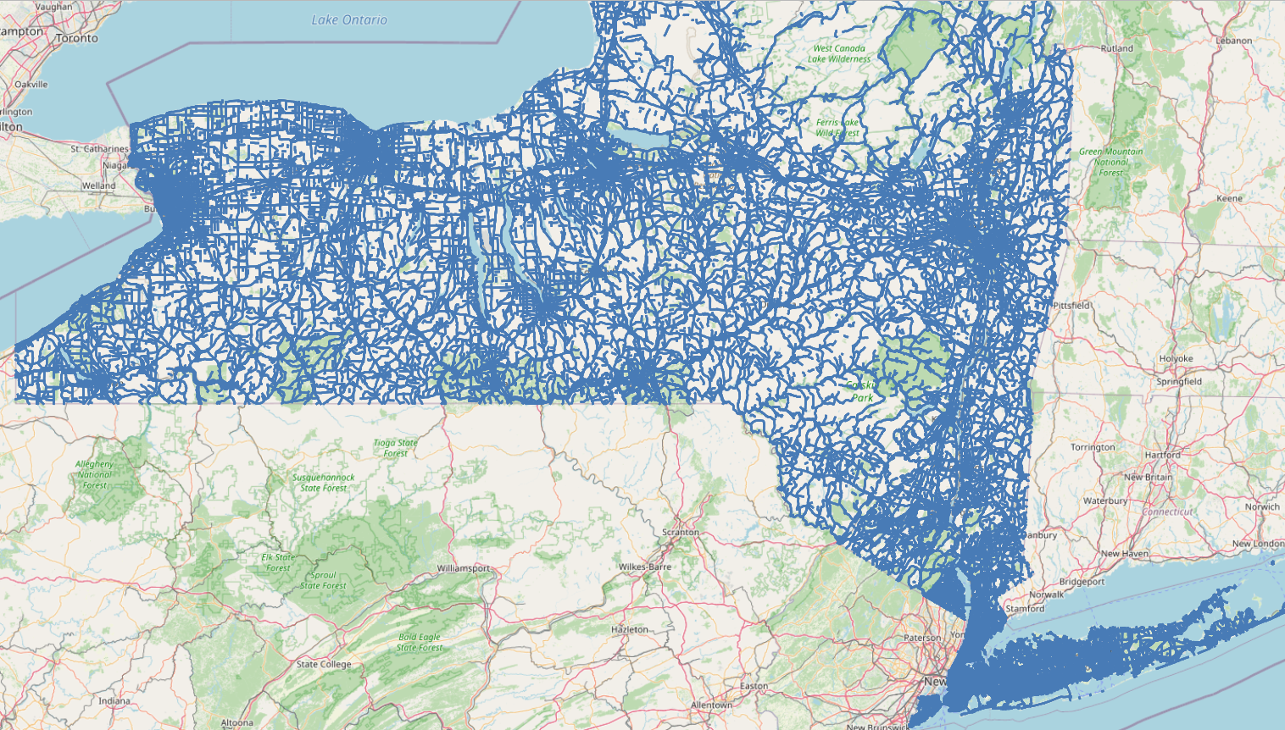
Data source
AADT (Annual Average Daily Traffic)
Snow depth (inches)
Speed limit (mph)
Road length (feet)

Slide 4
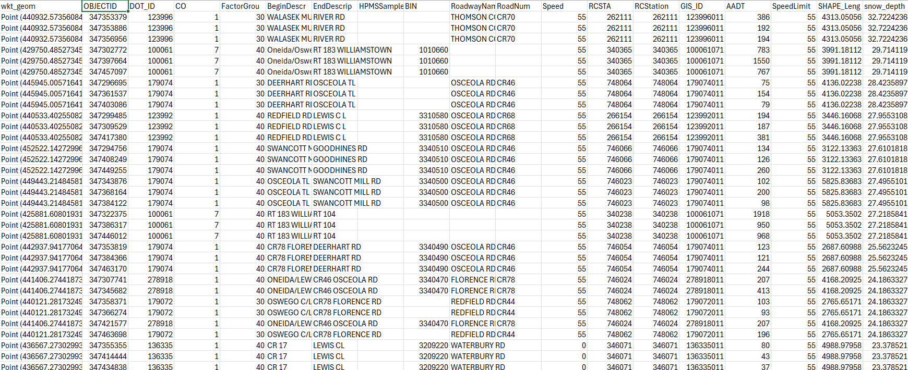

Slide 5
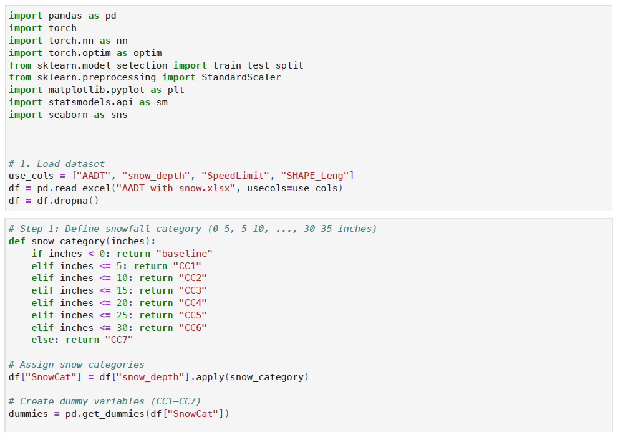
DATA ANALYSIS

Slide 6
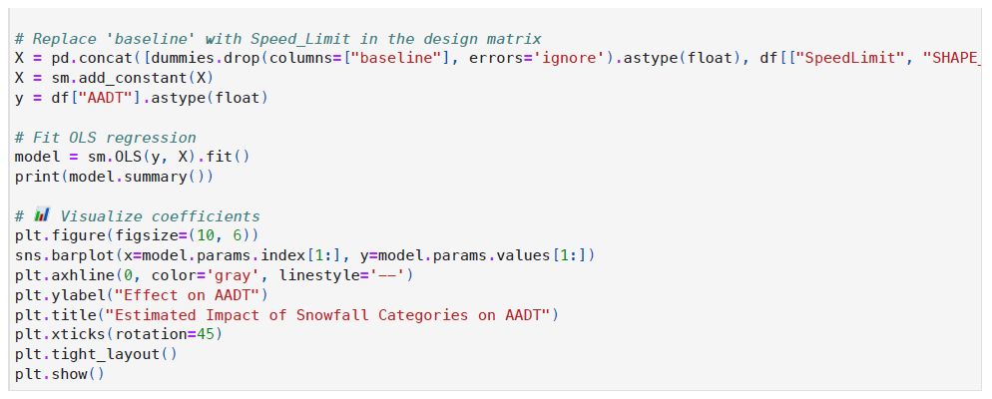
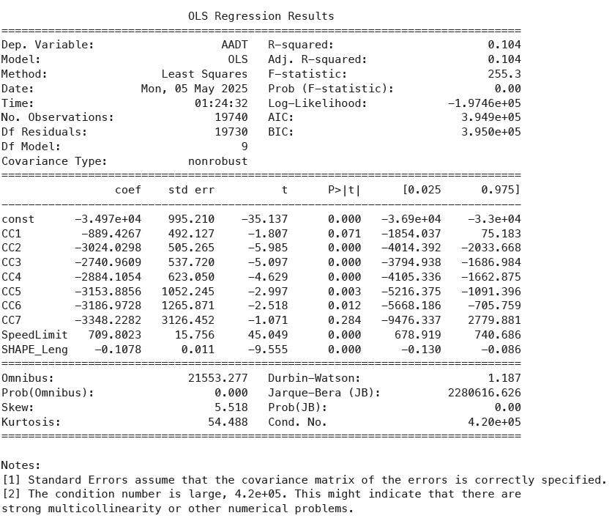
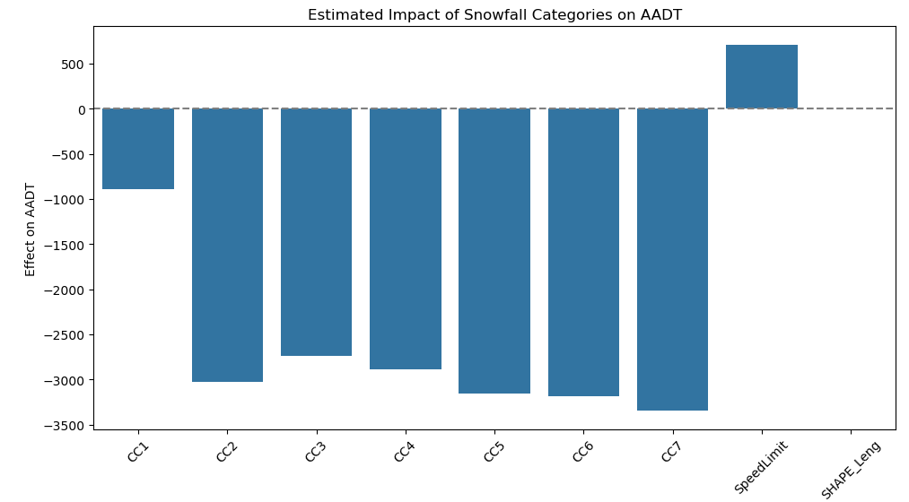

Slide 7
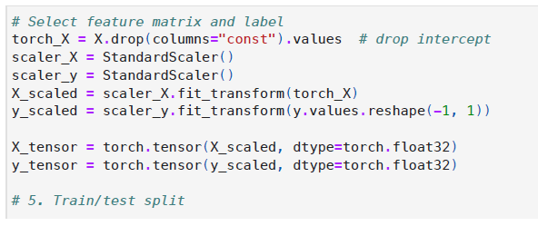
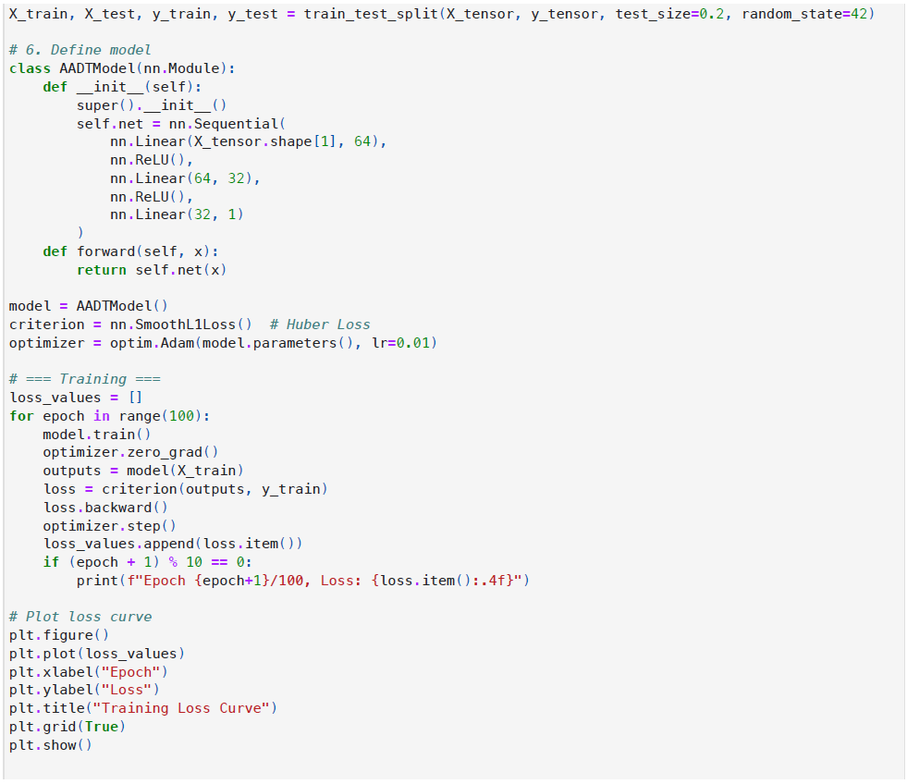

Slide 8
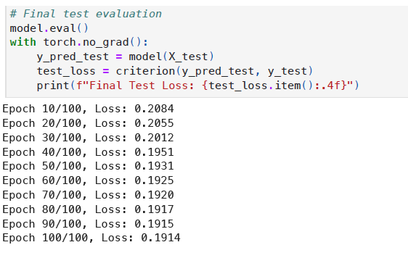
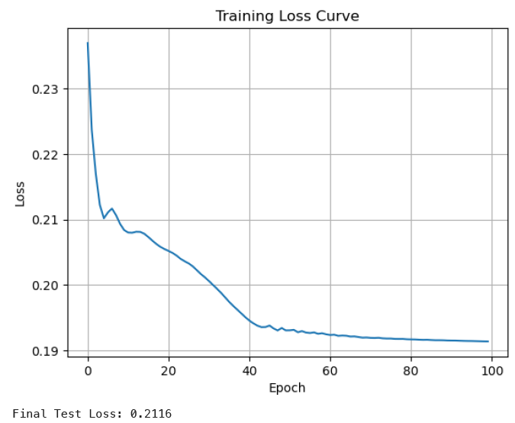

Slide 9
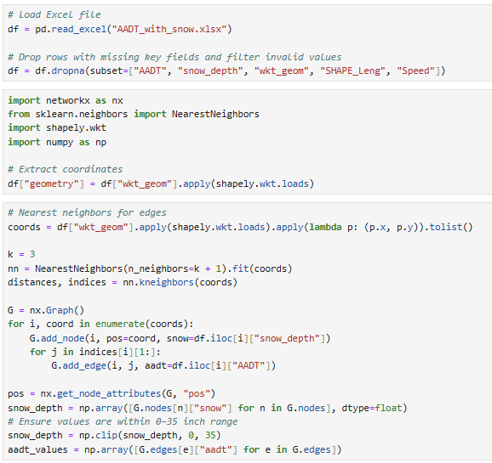
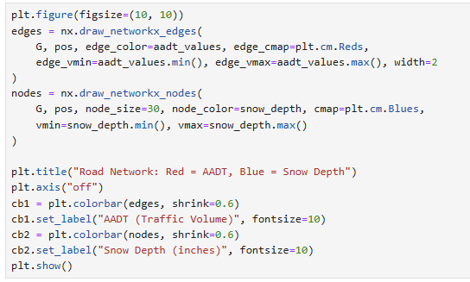

Slide 10
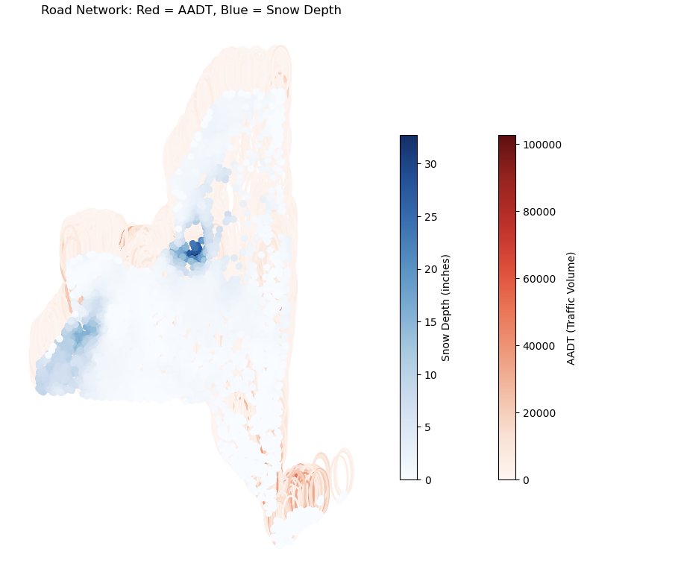

Slide 11
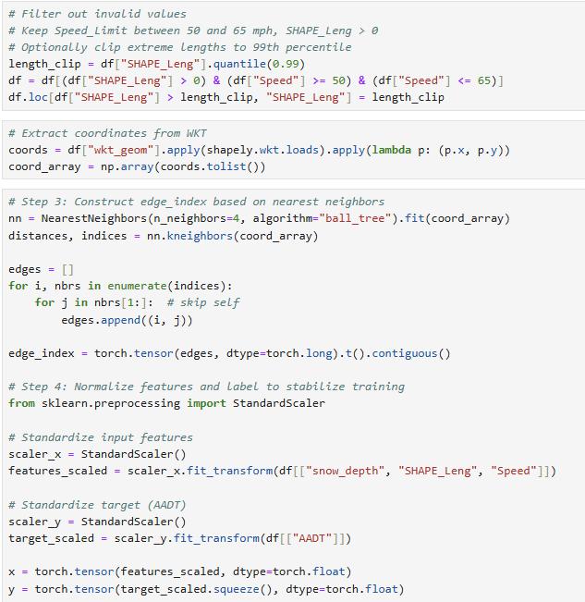
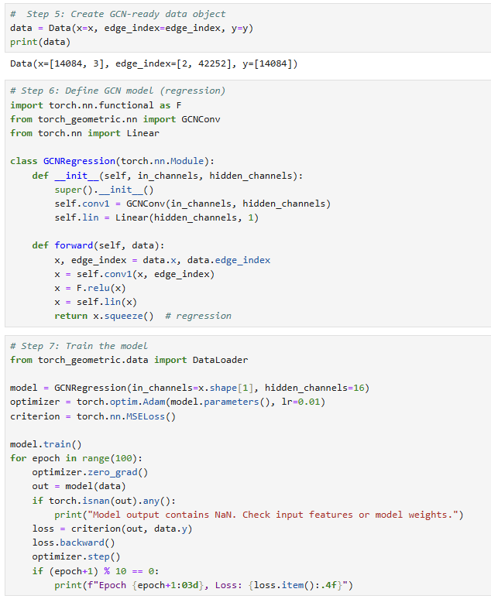

Slide 12
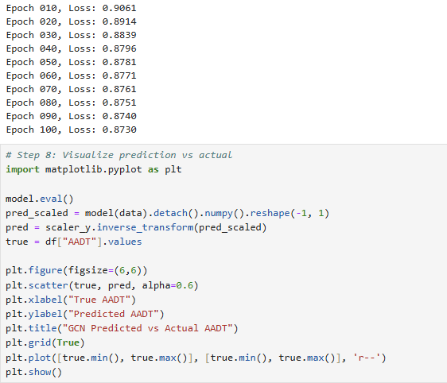
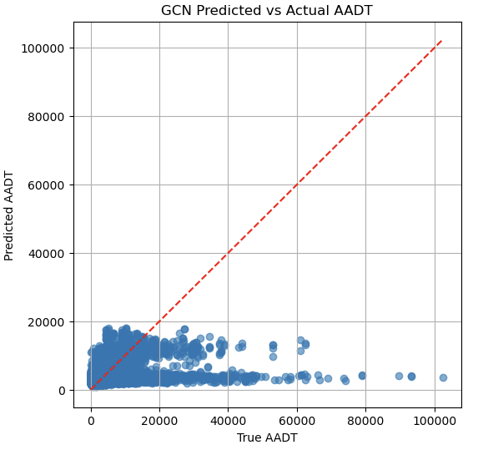

Slide 13
References
Modelling severe weather impact on traffic mobility and evaluating cross-regional applicability to functionally distinct segments in cold region highway networks, https://www.sciencedirect.com/science/article/pii/S2666188824002193
National Gridded Snowfall Analysis, https://www.nohrsc.noaa.gov/snowfall_v2/
NY State Thruway Roads, https://data.gis.ny.gov/maps/aa96f425af4e4b999a4b02ab7ee69286/about
Traffic Monitoring, https://data.gis.ny.gov/maps/d2eacb538cc14f0a94492868baf7fc8f/about

